Slide 1
Software engineering (Undergraduate)
Chapter 1 software requirements: what, why, who The essential of software requirements
Course Name software requirement engineering
CSC 4126
(Undergraduate)

Slide 2
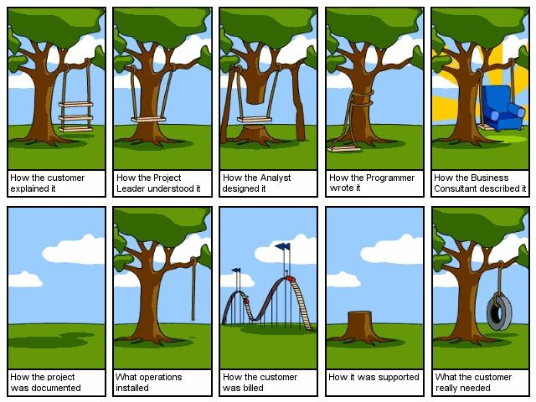
The current common problems
Slide - 2

Slide 3
The current common problems (CNTD.)
Slide - 3
Your customers approved the requirements for a release or iteration and then changed them continually.
The project scope increased as requirements changes were accepted, but the schedule slipped because no additional resources were provided and no functionality was removed.
Requested requirements changes got lost; no one knew the status of a particular change request.
Customers requested certain functionality and developers built it, but no one ever uses it.
At the end of the project, the specification was satisfied but the customer or the business objectives were not.

Slide 4
What is “REQUIREMENT”?
Slide - 4
A requirement is a property that a product must have to provide value to a stakeholder
Requirements are a specification of what should be implemented. They are descriptions of a system property or attribute or how the system should behave. They may be a constraint on the development process of the system.
Requirements encompass
the user’s view of the external system behaviour
the developer’s view of some internal characteristics
Software requirements include a time dimension
They could be present tense, describing the current system’s capabilities
Near-term (high priority) or hypothetical (low priority) future
They could even be past tense, referring to needs that were once specified and then discarded

Slide 5
Business requirements
Slide - 5
Business requirements describe why the organization is implementing the system — the business benefits the organization hopes to achieve
The focus is on the business objectives of the organization or the customer who requests the system (business requirements collected from multiple sources might conflict)
Suppose an airline wants to reduce airport counter staff costs by 25 percent. This goal might lead to the idea of building a kiosk that passengers can use to check in for their flights at the airport.
Self-service technologies (SSTs) have been applied to many areas of business
Business requirements typically come from the funding sponsor for a project, the acquiring customer, the manager of the actual users, the marketing department (to promote a product or service), or a product visionary

Slide 6
User Requirements
Slide - 6
User requirements describe goals or tasks the users must be able to perform with the product that will provide value to someone
Includes descriptions of product attributes or characteristics that are important to user satisfaction
Represent user requirements include use cases and user stories
User representatives will provide this information
Describes what the user will be able to do with the system
An example of a use case is “Check in for a flight” using an airline’s website or a kiosk at the airport. Written as a user story, the same user requirement might read: “As a passenger, I want to check in for a flight so I can board my airplane.”

Slide 7
Functional Requirements
Slide - 7
Functional requirements specify the behaviours the product will exhibit under specific conditions
They describe what the developers must implement to enable users to accomplish their tasks (user requirements), thereby satisfying the business requirements
Functional requirements often are written in the form of the traditional “shall” statements:
“The Passenger shall be able to print boarding passes for all flight segments for which he has checked in” or “If the Passenger’s profile does not indicate a seating preference, the reservation system shall assign a seat.”
A restriction that is imposed on the choices available to the developer for the design and construction of a product, is a CONSTRAINT
“The system shall be developed using open source tools and shall run on Linux OS”

Slide 8
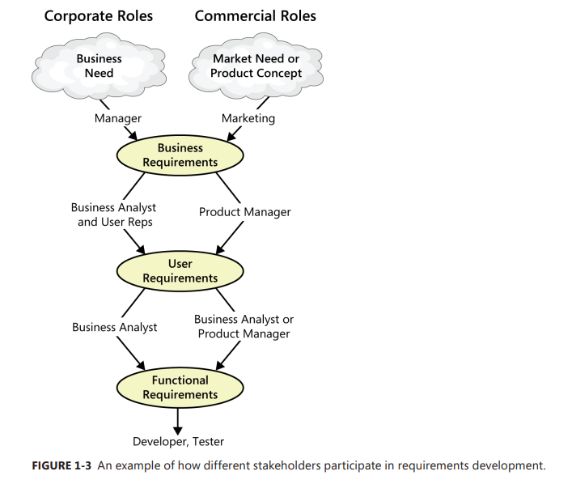
Levels of requirements
Slide - 8
Software requirements include three distinct levels:
Business requirements
User requirements
Functional requirements
This alignment among the three levels of requirements is essential for project success
Figure: Different stakeholders participate in requirements development

Slide 9
System Requirements
Slide - 9
System requirements describe the requirements for a product that is composed of multiple components or subsystems.
A system can be all software or it can include both software and hardware subsystems (e.g. biometric)
People and processes are part of a system, so certain system functions might be allocated to the human being
A good example of a “system” is the cashier’s workstation in a supermarket. There’s a bar code scanner and card reader. Also the cashier has a keyboard, a display, and a cash drawer, and printer to print to purchase receipt
The requirements for the system or product as a whole, then, lead the business analyst to derive specific functionality that must be allocated to one or another of those component subsystems, as well as demanding an understanding of the interfaces between them

Slide 10
Non-Functional Requirements
Slide - 10
Non-functional requirement are also known as quality attributes, product requirements that describes a service or performance characteristic of a product (“– ity, ilities.”)
Describe the product’s characteristics in various dimensions that are important either to users or to developers and maintainers, such as performance, safety, availability, and portability (chances of conflicts within non-functional requirements are fairly high)
Other classes of non-functional requirements describe external interfaces between the system and the outside world (usefulness, flexibility, reliability)
These include connections to other software systems, hardware components, and users, as well as communication interfaces (interoperability)
Design and implementation constraints impose restrictions on the options available to the developer during construction of the product (security)

Slide 11
Business Rules
Slide - 11
Business rules include corporate policies, government regulations, industry standards, and computational algorithms
Business rules are not themselves software requirements because they have an existence beyond the boundaries of any specific software application
They often dictate that the system must contain functionality to comply with the relevant rules (e.g. online purchase limit)
A restriction that is imposed on the choices available to the developer for the design and construction of a product (e.g. no red colour in webpage – Inverse requirements)
Sometimes, as with corporate security policies, business rules are the origin of specific quality attributes that are then implemented in functionality (e.g. firewall is functional requirement and security is quality requirements)
Therefore, you can trace the origin of certain functional requirements back to a particular business rule

Slide 12
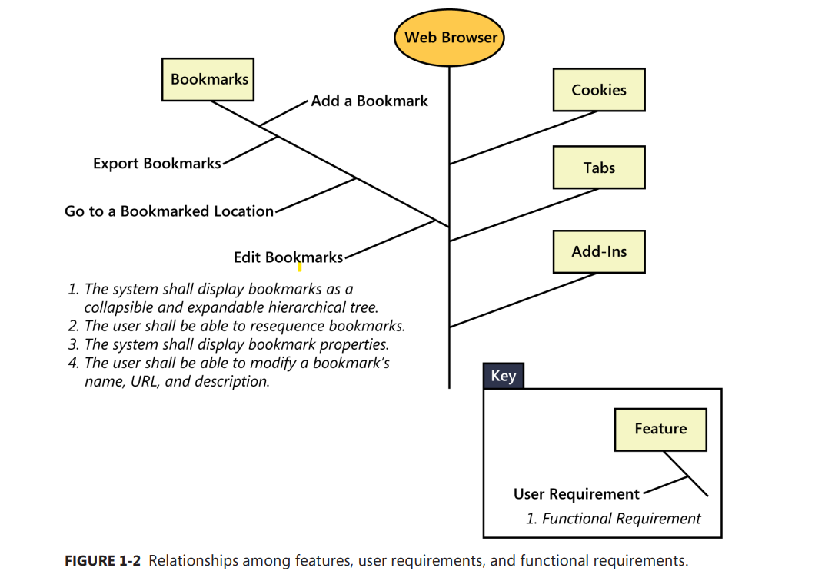
Feature
Slide - 13
A feature consists of one or more logically related system capabilities that provide value to a user and are described by a set of functional requirements
A feature can encompass multiple user requirements, each of which implies that certain functional requirements must be implemented to allow the user to perform the task described by each user requirement

Slide 13
Feature
Slide - 13

Slide 14
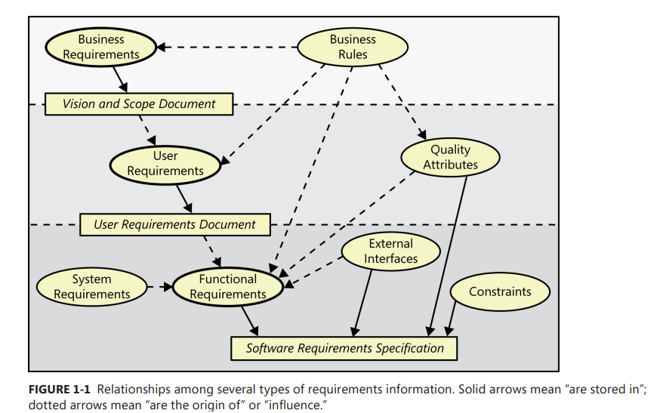
Relationships
Slide - 14

Slide 15
Product vs. Project Requirements
Slide - 15
Requirements that describe properties of a software system to be built are called product requirements.
Projects certainly do have other expectations and deliverables that are not a part of the software the team implements, but that are necessary to the successful completion of the project as a whole. These are project requirements but not product requirements. (maintain schedule deadline of task)
An SRS houses the product requirements, but it should not include design or implementation details (other than known constraints), project plans, test plans, or similar information.
Separate out such items so that requirements development activities can focus on understanding what the team intends to build.

Slide 16
Project Requirements
Slide - 16
Physical resources the development team needs, such as workstations, special hardware devices, testing labs, testing tools and equipment, team rooms, and videoconferencing equipment.
Staff training (User documentation, including training materials, tutorials, reference manuals, and release notes)
Infrastructure changes needed in the operating environment.
Requirements and procedures for releasing the product, installing it in the operating environment, configuring it, and testing the installation.
Beta testing, manufacturing, packaging, marketing, and distribution requirements.
Customer service-level agreements (SLAs).
Requirements for obtaining legal protection (patents, trademarks, or copyrights) for intellectual property related to the software.

Slide 17
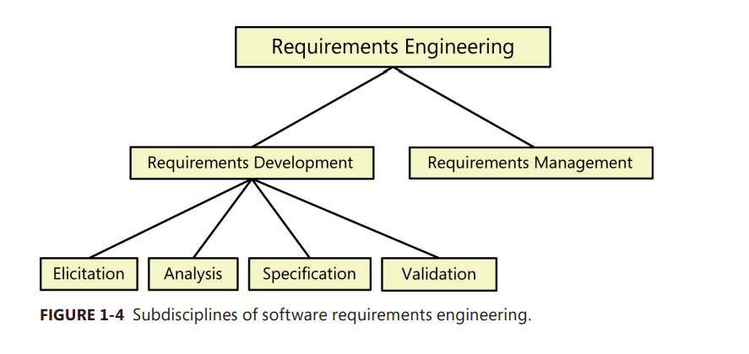
Requirements Development and management
Slide - 17

Slide 18
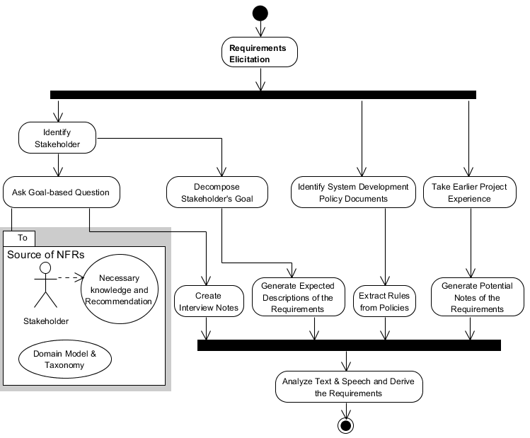
Requirements Development: ELICITATION
Slide - 18
Identifying the product’s expected user classes and other stakeholders.
Understanding user tasks and goals and the business objectives with which those tasks align.
Learning about the environment in which the new product will be used.
Working with individuals who represent each user class to understand their functionality needs and their quality expectations.

Slide 19
Requirements Development: ANALYSIS
Slide - 19
Model the application environment
Analysing the information received from users to distinguish their task goals into functional requirements, quality expectations, business rules, suggested solutions, etc.
Decomposing high-level requirements into an appropriate level of detail
Allocating requirements to software components defined in the system architecture
Negotiating requirements priority and their implementation priorities

Slide 20
Requirements Development: Specification
Slide - 20
The business analyst documents requirements in a software requirements specification (SRS).
Transcribing the collected user needs into written requirements and diagrams suitable for comprehension, review, and use by their intended audiences.
The SRS describes as fully as necessary the expected behaviour of the software system.
The SRS is used in development, testing, quality assurance, project management, and related project functions.
Adopt requirement document templates (well defined standard of writing requirements)
Identify requirement origins
Uniquely label each requirement and cross-cutting requirements concern

Slide 21
Requirements Development: Validation
Slide - 21
Reviewing the documented requirements (SRS) to correct any problems before the development group accepts them (feasible, consistent, complete)
Consistency means that no requirements should be contradictory; Completeness means that no services or constraints which are needed have been missed out. Also, discard unnecessary requirements
Developing acceptance tests and criteria to confirm that a product based on the requirements would meet customer needs and achieve the business objectives.
Simulate the requirements (e.g. wareframming) to find errors.

Slide 22
A requirements development process framework
Slide - 22

Slide 23
A requirements development process framework
Slide - 23
expand

Slide 24
Requirements Management
Slide - 24
Establish a requirements change control process
Perform impact analysis on requirements changes
Track the status of each requirement; Track requirements issues
Maintain a history of requirements changes
Maintain a requirements traceability matrix
Defining the relationships and dependencies that exist between requirements
Tracing individual requirements to their corresponding designs, source code, and tests

Slide 25
Requirements Management (cntd.)
Slide - 25

Slide 26
A requirements development process framework
Slide - 26
Time box – 1month

Slide 27
Role of Requirements
Slide - 27
“The hardest single part of building a software system is deciding precisely what to build. No other part of the conceptual work is as difficult as establishing the detailed technical requirements, including all the interfaces to people, to machines, and to other software systems. No other part of the work so cripples the resulting system if done wrong. No other part is more difficult to rectify later.”

Slide 28
Reasons Behind Bad Requirements
Slide - 28
Insufficient user involvement
Inaccurate planning
Creeping (gradually increase, changing) user requirements
Ambiguous requirements (e.g. response to a request as soon as possible)
Gold plating (extra functionality beyond the specification)
Overlooked stakeholders

Slide 29
Benefits of a high quality requirements process
Slide - 29
Fewer defects in requirements and in the delivered product
Reduced development rework
Faster development and delivery
Fewer unnecessary and unused features
Lower enhancement costs
Fewer miscommunications
Reduced scope creep
Reduced project chaos
Higher customer and team member satisfaction
Products that do what they’re supposed to do

Slide 30
References
Slide - 30
Wiegers, K., & Beatty, J. (2013). Software requirements. Pearson Education.
http://www.cs.ccsu.edu/~stan/classes/CS530/notes14/04-Requirements.html

